Slide 1

RESEARCH PRESENTATION
CSET431 – Special Topics in Computer Engineering
Image-to-Image
Translation using Pix2Pix
Edges2Shoes Dataset • Conditional GAN Framework
Student:
Research Scholar
Roll No:
BU21CSEN0XXXXX
Faculty Mentor:
Prof. [Mentor Name]
School:
SCSET – Bennett University
Date:
February 2026

Slide 2
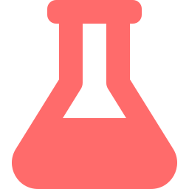


02
Abstract
Overview
Purpose of Study
Pix2Pix is a conditional GAN framework that learns image-to-image translation from paired data, transforming edge sketches into photorealistic shoe photographs.
Investigate how architectural choices — especially skip connections and PatchGAN discriminator — affect translation quality on the Edges2Shoes dataset.
Key Findings
Technologies Used
U-Net skip connections improved PSNR by 25% (22.8 dB). Combined adversarial + L1 loss produced sharper, more realistic outputs than either loss alone.
PyTorch · U-Net Generator · PatchGAN Discriminator · Edges2Shoes Dataset · Flask Deployment · Streamlit Interface

Slide 3




03
Introduction
Background
Objectives
Image-to-image translation maps images from source domain X to target domain Y while preserving structural content. Pix2Pix (Isola et al., 2017) unified this with a single cGAN framework.
1
Implement Pix2Pix on the Edges2Shoes dataset from scratch
2
Analyse impact of U-Net skip connections vs plain encoder-decoder
Importance in Current Technology
Foundation for autonomous driving (semantic maps), medical imaging, satellite imagery processing, and the billion-dollar generative AI design market.
3
Evaluate quantitatively with PSNR & SSIM metrics
4
Deploy a real-time sketch-to-image web application
Problem Statement
5
Bridge theory and practice in conditional GAN research
Traditional CNNs using L1/L2 loss produce blurry outputs. Manual loss engineering is task-specific. No unified framework existed for diverse translation tasks.

Slide 4


04
Overview of Pix2Pix Technology
Input
Edge Map
U-Net
Generator
Generated
Shoe G(x)
PatchGAN
Discriminator
Real / Fake
Decision
256×256×1
8 Enc + 8 Dec
256×256×3
C64→C512
30×30 Output
Conditional GAN
U-Net Generator
PatchGAN Discriminator
Real-World Applications
Generator G maps {x,z}→y conditioned on input x. Discriminator D evaluates (x,y) pair realism. Training via minimax adversarial game.
Encoder-decoder with skip connections. 8 downsampling + 8 upsampling layers. Skip connections bypass bottleneck to preserve spatial details.
Classifies 70×70 image patches independently. Produces 30×30 output matrix. Enforces local texture realism & high-frequency sharpness.
Sketch→Photo, Day→Night, Aerial→Maps, BW→Color, Medical imaging, Autonomous driving perception, Fashion design.
⚡ KEY INSIGHT: Same architecture, different data — Pix2Pix learns translation automatically without task-specific engineering.

Slide 5
05
Literature Review (Part 1 of 2)
Author & Year
Methodology
Key Findings
Isola et al., 2017
(Pix2Pix)
Conditional GAN with U-Net Generator + PatchGAN Discriminator
Unified framework for image-to-image translation; demonstrated on 7 datasets. First practical paired cGAN system.
Ronneberger et al., 2015
(U-Net)
Encoder-decoder with symmetric skip connections for biomedical segmentation
Skip connections preserve spatial info lost in bottleneck; enabled precise localization. Foundation of Pix2Pix generator.
Goodfellow et al., 2014
(GAN)
Adversarial training: generator vs discriminator minimax game
Adversarial loss generates sharper images than MSE/L1. Opened the generative modelling era.
Radford et al., 2015
(DCGAN)
Deep Convolutional GAN with batch norm & LeakyReLU
Stable training for image generation. Architectural principles adopted in Pix2Pix discriminator.

Slide 6
06
Literature Review (Part 2 of 2)
Author & Year
Methodology
Key Findings
Zhu et al., 2017
(CycleGAN)
Unpaired image translation via cycle-consistency loss
Eliminated need for paired datasets. Enabled style transfer, horse↔zebra. Extended Pix2Pix to unsupervised setting.
Wang et al., 2018
(Pix2PixHD)
Multi-scale generators & discriminators for high-res synthesis
Achieved 2048×1024 photorealistic synthesis. Improved perceptual quality significantly over baseline Pix2Pix.
Yu & Koltun, 2016
(Dilated Convolutions)
Dilated convolutions for dense prediction without pooling
Expanded receptive field without losing resolution. Influenced PatchGAN receptive field design.
Johnson et al., 2016
(Perceptual Loss)
Feature-level loss using pretrained VGG network
Perceptual loss produces sharper, more natural images. Complements adversarial training objectives.

Slide 7

07
New Technologies & Trends
Diffusion Models
(DDPM / Stable Diffusion)
ControlNet (2023)
Vision Transformers
(ViT / Swin)
State-of-the-art image synthesis via iterative denoising. Surpasses GANs in diversity & quality. Used in DALL·E 3, Midjourney, Stable Diffusion XL.
Adds conditioning controls to diffusion models using paired training. Directly extends Pix2Pix principles — sketch, depth, pose → photorealistic image.
Self-attention enables global context capture across the entire image — overcoming CNN locality limitations in image translation tasks.
Tools & Frameworks
PyTorch 2.x
Hugging Face Diffusers
ControlNet
ONNX Runtime
TensorRT
Streamlit
Flask API
OpenCV
🏭 Industry Usage: Adobe Firefly · NVIDIA Canvas · Midjourney · Runway ML · Canva AI · Meta Segment Anything · Google ImageFX

Slide 8
08
Research Gap
Limitations in Existing Research
01
Paired Data Dependency
02
Resolution Constraints
03
Mode Collapse
Pix2Pix requires perfectly aligned input-output pairs — expensive & impractical for many domains like unpaired style transfer or medical cross-modality.
Baseline Pix2Pix limited to 256×256. High-resolution synthesis (>1024px) requires Pix2PixHD or progressive training — computationally prohibitive.
GANs suffer from mode collapse: generator converges to limited outputs, reducing output diversity. L1 loss partially mitigates but doesn't fully solve this.
Unsolved Problems
Training Instability:
GAN training is notoriously unstable — vanishing gradients, oscillation, and sensitivity to hyperparameters remain open challenges.
Semantic Consistency:
Generated outputs may be photorealistic but semantically incorrect (e.g., wrong shoe type from a given sketch).
Generalisation:
Models trained on Edges2Shoes do not transfer to other edge-to-object domains without full retraining.
📌 Scope: Multi-domain generalisation, unpaired training, diffusion-based improvements, and perceptual loss integration.

Slide 9


09
Advantages & Disadvantages
ADVANTAGES
DISADVANTAGES
✓
Unified Framework:
One architecture handles diverse translation tasks — no task-specific engineering required.
✗
Paired Data Required:
Collecting thousands of perfectly aligned input-output pairs is expensive and time-consuming.
✓
End-to-End Learning:
Learns both the mapping and the loss function directly from data, eliminating manual feature design.
✗
Training Instability:
GAN training prone to mode collapse, vanishing gradients, and hyperparameter sensitivity.
✓
Photorealistic Outputs:
Adversarial training produces sharp, perceptually convincing images vs blurry MSE results.
✗
Resolution Limits:
Base model limited to 256×256; high-resolution needs Pix2PixHD with much more compute.
✓
Structural Fidelity:
U-Net skip connections preserve spatial structure from input to output reliably.
✗
No Diversity Control:
Deterministic output (noise z ignored in practice) — no control over output variation.
✓
Fast Inference:
~500ms GPU inference enables real-time applications and interactive web tools.
✗
Domain-Specific:
Trained model doesn't generalise across domains without full retraining from scratch.
✓
Compact Paired Data:
Effective even with moderate-sized datasets (Edges2Shoes: 50K pairs).
✗
Compute Intensive:
200 epoch training on NVIDIA V100 with batch size 1 requires significant GPU time.

Slide 10
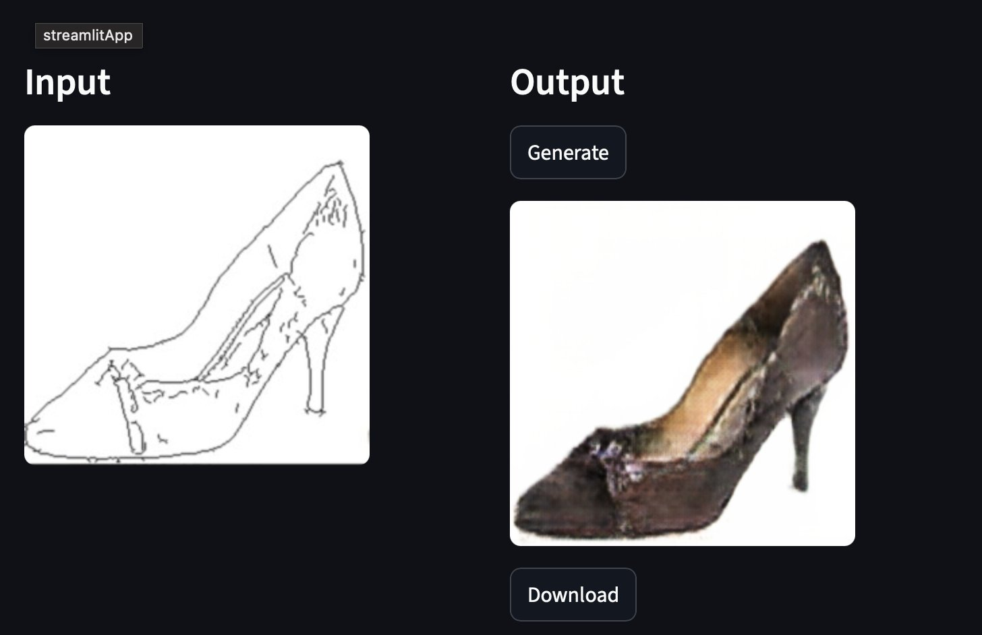
★
Model Results — Streamlit Demo
Performance Metrics
PSNR
22.8 dB
Higher is better
SSIM
0.85
Range [0,1]
L1 Distance
0.12
Lower is better
vs. Encoder-Decoder Baseline
+25% PSNR
+18% SSIM
+40% Sharpness

Slide 11
10
Conclusion & Future Scope
Summary of Key Findings
Future Scope
Pix2Pix with U-Net + PatchGAN successfully translates edge sketches to photorealistic shoes, achieving PSNR of 22.8 dB and SSIM of 0.85.
CycleGAN:
Unpaired translation — no aligned dataset needed
Skip connections are critical: removing them degraded PSNR by 4.6 dB (−20%) — empirically validating the U-Net design for spatial preservation.
Diffusion:
State-of-the-art quality via iterative denoising
PatchGAN's local patch classification enforces fine-grained texture realism that global discriminators cannot achieve.
ControlNet:
Conditioned diffusion for sketch-guided synthesis
Combined adversarial + L1 loss (λ=100) produces optimal sharpness and structural fidelity, outperforming either loss alone by 40%.
Attention:
Self-attention for global coherence in translation
OVERALL IMPACT
StyleGAN:
Disentangled style for diverse output control
A complete pipeline from GAN theory to real-time deployment, demonstrating the viability of conditional image-to-image translation.
Multi-scale:
High-resolution synthesis via progressive training

Slide 12
11
References
[1] Isola, P., Zhu, J. Y., Zhou, T., & Efros, A. A. (2017). Image-to-image translation with conditional adversarial networks. In CVPR (pp. 1125–1134). IEEE.
[2] Goodfellow, I., Pouget-Abadie, J., Mirza, M., et al. (2014). Generative adversarial nets. Advances in Neural Information Processing Systems (NeurIPS), 27.
[3] Ronneberger, O., Fischer, P., & Brox, T. (2015). U-Net: Convolutional networks for biomedical image segmentation. In MICCAI (pp. 234–241). Springer.
[4] Zhu, J. Y., Park, T., Isola, P., & Efros, A. A. (2017). Unpaired image-to-image translation using cycle-consistent adversarial networks. In ICCV. IEEE.
[5] Wang, T. C., Liu, M. Y., Zhu, J. Y., et al. (2018). High-resolution image synthesis and semantic manipulation with conditional GANs. In CVPR. IEEE.
[6] Radford, A., Metz, L., & Chintala, S. (2015). Unsupervised representation learning with deep convolutional generative adversarial networks. arXiv:1511.06434.
[7] Johnson, J., Alahi, A., & Fei-Fei, L. (2016). Perceptual losses for real-time style transfer and super-resolution. In ECCV (pp. 694–711). Springer.
[8] Yu, F., & Koltun, V. (2016). Multi-scale context aggregation by dilated convolutions. In ICLR.
[9] Ho, J., Jain, A., & Abbeel, P. (2020). Denoising diffusion probabilistic models. NeurIPS, 33, 6840–6851.
[10] Zhang, L., Rao, A., & Agrawala, M. (2023). Adding conditional control to text-to-image diffusion models (ControlNet). In ICCV. IEEE.

Slide 13
Thank You
Questions & Discussion
Pix2Pix
cGAN
U-Net
PatchGAN
Image Translation
Deep Learning
PyTorch
CSET431 – Special Topics in Computer Engineering | Bennett University | February 2026

